Slide 1
Fundamentals of Ecology
Week 8, Ecology Lecture 6
Cara Brook
February 23, 2023

Slide 2
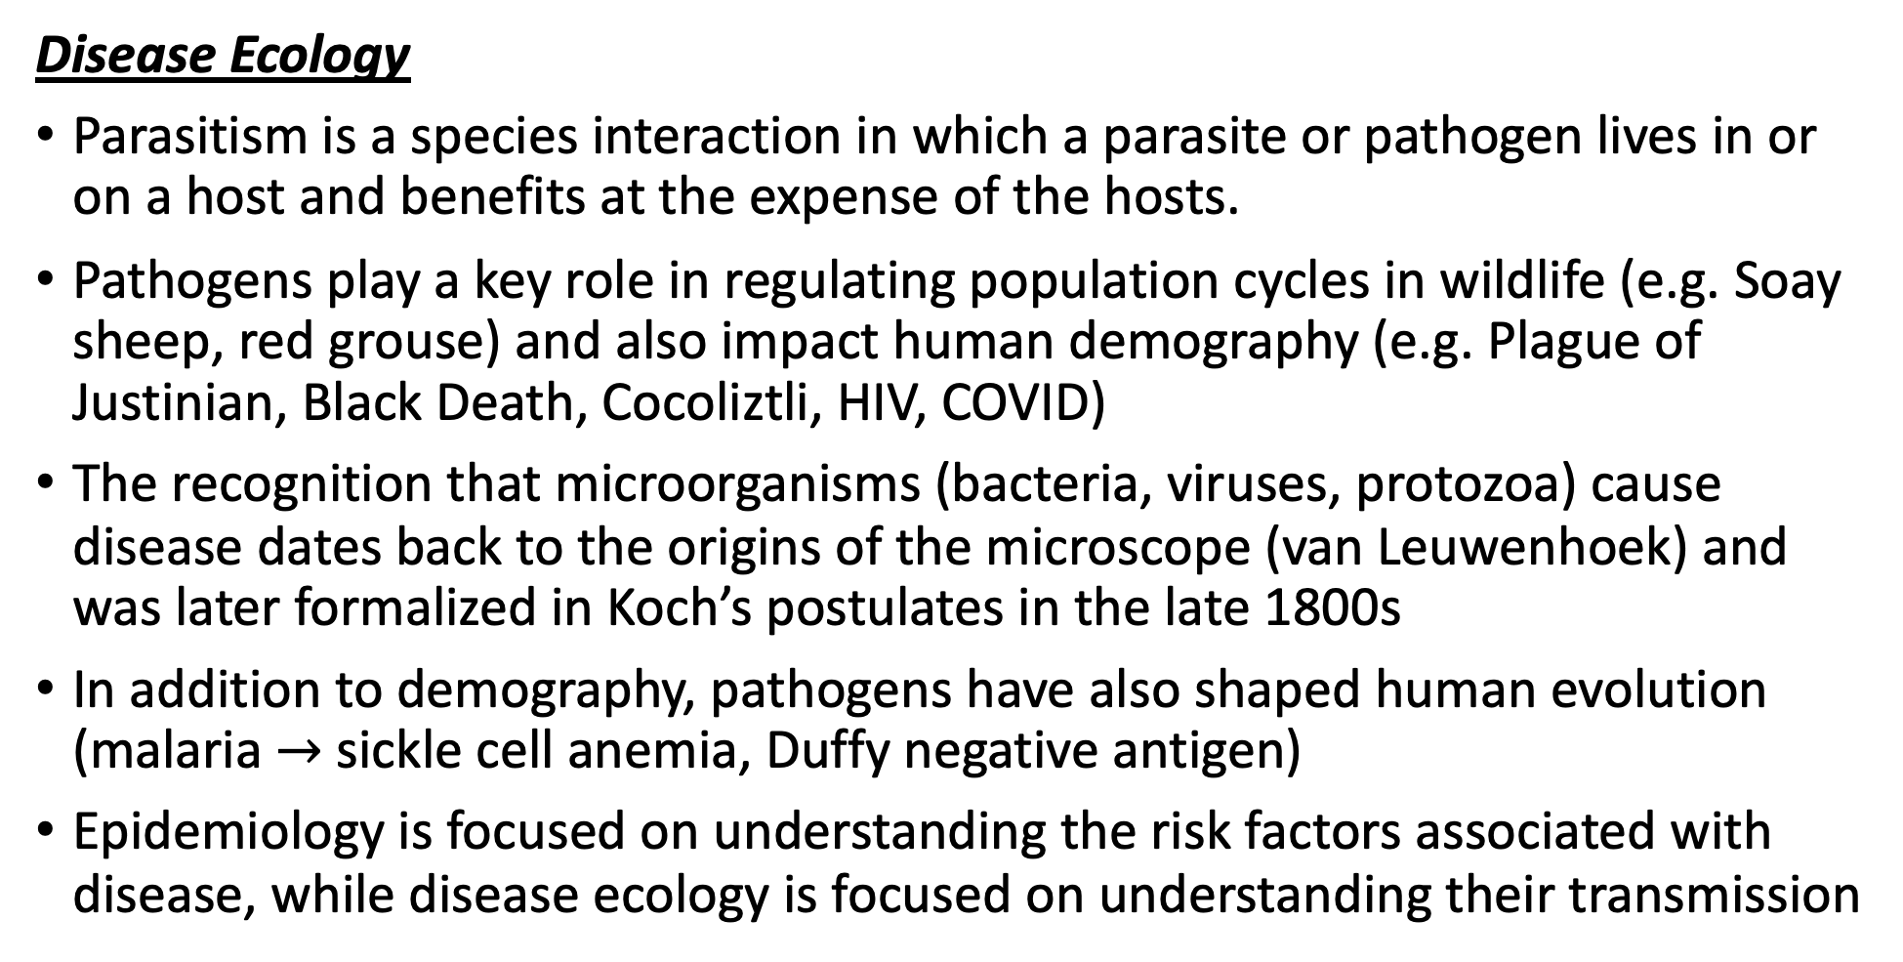
Let’s recap a bit!
Disease Ecology
Parasitism is a species interaction in which a parasite or pathogen lives in or on a host and benefits at the expense of the hosts.
Pathogens play a key role in regulating population cycles in wildlife (e.g. Soay sheep, red grouse) and also impact human demography (e.g. Plague of Justinian, Black Death, Cocoliztli, HIV, COVID)
The recognition that microorganisms (bacteria, viruses, protozoa) cause disease dates back to the origins of the microscope (van Leuwenhoek) and was later formalized in Koch’s postulates in the late 1800s
In addition to demography, pathogens have also shaped human evolution (malaria $→$ sickle cell anemia, Duffy negative antigen)
Epidemiology is focused on understanding the risk factors associated with disease, while disease ecology is focused on understanding their transmission

Slide 3
Let’s recap a bit!
Disease Ecology
Parasitism is a species interaction in which a parasite or pathogen lives in or on a host and benefits at the expense of the hosts.
Pathogens play a key role in regulating population cycles in wildlife (e.g. Soay sheep, red grouse) and also impact human demography (e.g. Plague of Justinian, Black Death, Cocoliztli, HIV, COVID)
The recognition that microorganisms (bacteria, viruses, protozoa) cause disease dates back to the origins of the microscope (van Leuwenhoek) and was later formalized in Koch’s postulates in the late 1800s
In addition to demography, pathogens have also shaped human evolution (malaria $→$ sickle cell anemia, Duffy negative antigen)
Epidemiology is focused on understanding the risk factors associated with disease, while disease ecology is focused on understanding their transmission

Slide 4
Let’s recap a bit!
Disease Ecology
Parasitism is a species interaction in which a parasite or pathogen lives in or on a host and benefits at the expense of the hosts.
Pathogens play a key role in regulating population cycles in wildlife (e.g. Soay sheep, red grouse) and also impact human demography (e.g. Plague of Justinian, Black Death, Cocoliztli, HIV, COVID)
The recognition that microorganisms (bacteria, viruses, protozoa) cause disease dates back to the origins of the microscope (van Leuwenhoek) and was later formalized in Koch’s postulates in the late 1800s
In addition to demography, pathogens have also shaped human evolution (malaria $→$ sickle cell anemia, Duffy negative antigen)
Epidemiology is focused on understanding the risk factors associated with disease, while disease ecology is focused on understanding their transmission

Slide 5
Let’s recap a bit!
Disease Ecology
Parasitism is a species interaction in which a parasite or pathogen lives in or on a host and benefits at the expense of the hosts.
Pathogens play a key role in regulating population cycles in wildlife (e.g. Soay sheep, red grouse) and also impact human demography (e.g. Plague of Justinian, Black Death, Cocoliztli, HIV, COVID)
The recognition that microorganisms (bacteria, viruses, protozoa) cause disease dates back to the origins of the microscope (van Leuwenhoek) and was later formalized in Koch’s postulates in the late 1800s
In addition to demography, pathogens have also shaped human evolution (malaria $→$ sickle cell anemia, Duffy negative antigen)
Epidemiology is focused on understanding the risk factors associated with disease, while disease ecology is focused on understanding their transmission

Slide 6
Let’s recap a bit!
Disease Ecology
Parasitism is a species interaction in which a parasite or pathogen lives in or on a host and benefits at the expense of the hosts.
Pathogens play a key role in regulating population cycles in wildlife (e.g. Soay sheep, red grouse) and also impact human demography (e.g. Plague of Justinian, Black Death, Cocoliztli, HIV, COVID)
The recognition that microorganisms (bacteria, viruses, protozoa) cause disease dates back to the origins of the microscope (van Leuwenhoek) and was later formalized in Koch’s postulates in the late 1800s
In addition to demography, pathogens have also shaped human evolution (malaria $→$ sickle cell anemia, Duffy negative antigen)
Epidemiology is focused on understanding the risk factors associated with disease, while disease ecology is focused on understanding their transmission

Slide 7
Let’s recap a bit!
Disease Ecology
Parasitism is a species interaction in which a parasite or pathogen lives in or on a host and benefits at the expense of the hosts.
Pathogens play a key role in regulating population cycles in wildlife (e.g. Soay sheep, red grouse) and also impact human demography (e.g. Plague of Justinian, Black Death, Cocoliztli, HIV, COVID)
The recognition that microorganisms (bacteria, viruses, protozoa) cause disease dates back to the origins of the microscope (van Leuwenhoek) and was later formalized in Koch’s postulates in the late 1800s
In addition to demography, pathogens have also shaped human evolution (malaria $→$ sickle cell anemia, Duffy negative antigen)
Epidemiology is focused on understanding the risk factors associated with disease, while disease ecology is focused on understanding their transmission

Slide 8
Let’s recap a bit!
Disease Ecology
Parasitism is a species interaction in which a parasite or pathogen lives in or on a host and benefits at the expense of the hosts.
Pathogens play a key role in regulating population cycles in wildlife (e.g. Soay sheep, red grouse) and also impact human demography (e.g. Plague of Justinian, Black Death, Cocoliztli, HIV, COVID)
The recognition that microorganisms (bacteria, viruses, protozoa) cause disease dates back to the origins of the microscope (van Leuwenhoek) and was later formalized in Koch’s postulates in the late 1800s
In addition to demography, pathogens have also shaped human evolution (malaria $→$ sickle cell anemia, Duffy negative antigen)
Epidemiology is focused on understanding the risk factors associated with disease, while disease ecology is focused on understanding their transmission

Slide 9
Let’s recap a bit!
Disease Ecology
We model transmission dynamics using the Susceptible-Infected-Recovered (SIR) model, where hosts are classed according to their infectious status.
R₀, the basic reproduction number for a pathogen, describes the number of new infections generated by a single infection in a completely susceptible population. It is expressed with the terms of infections gained / infections lost.
RE, or Rt, is the effective reproduction number. It is R₀*the proportion susceptible. Epidemics grow at R_{E}>1 and decline at R_{E}<1.
We can leverage this RE equation to describe the proportion of the population needed to vaccinate to eradicate a pathogen: PV = 1 – 1/R0
Vaccination dates back to antiquity but does not work equally well for all pathogen types and faces many challenges because most pathogens do not follow the simplistic dynamics of measles.

Slide 10
Let’s recap a bit!
Disease Ecology
We model transmission dynamics using the Susceptible-Infected-Recovered (SIR) model, where hosts are classed according to their infectious status.
R₀, the basic reproduction number for a pathogen, describes the number of new infections generated by a single infection in a completely susceptible population. It is expressed with the terms of infections gained / infections lost.
RE, or Rt, is the effective reproduction number. It is R₀*the proportion susceptible. Epidemics grow at R_{E}>1 and decline at R_{E}<1.
We can leverage this RE equation to describe the proportion of the population needed to vaccinate to eradicate a pathogen: PV = 1 – 1/R0
Vaccination dates back to antiquity but does not work equally well for all pathogen types and faces many challenges because most pathogens do not follow the simplistic dynamics of measles.

Slide 11
Let’s recap a bit!
Disease Ecology
We model transmission dynamics using the Susceptible-Infected-Recovered (SIR) model, where hosts are classed according to their infectious status.
R₀, the basic reproduction number for a pathogen, describes the number of new infections generated by a single infection in a completely susceptible population. It is expressed with the terms of infections gained / infections lost.
RE, or Rt, is the effective reproduction number. It is R₀*the proportion susceptible. Epidemics grow at R_{E}>1 and decline at R_{E}<1.
We can leverage this RE equation to describe the proportion of the population needed to vaccinate to eradicate a pathogen: PV = 1 – 1/R0
Vaccination dates back to antiquity but does not work equally well for all pathogen types and faces many challenges because most pathogens do not follow the simplistic dynamics of measles.

Slide 12
Let’s recap a bit!
Disease Ecology
We model transmission dynamics using the Susceptible-Infected-Recovered (SIR) model, where hosts are classed according to their infectious status.
R₀, the basic reproduction number for a pathogen, describes the number of new infections generated by a single infection in a completely susceptible population. It is expressed with the terms of infections gained / infections lost.
RE, or Rt, is the effective reproduction number. It is R₀*the proportion susceptible. Epidemics grow at R_{E}>1 and decline at R_{E}<1.
We can leverage this RE equation to describe the proportion of the population needed to vaccinate to eradicate a pathogen: PV = 1 – 1/R0
Vaccination dates back to antiquity but does not work equally well for all pathogen types and faces many challenges because most pathogens do not follow the simplistic dynamics of measles.

Slide 13
Let’s recap a bit!
Disease Ecology
We model transmission dynamics using the Susceptible-Infected-Recovered (SIR) model, where hosts are classed according to their infectious status.
R₀, the basic reproduction number for a pathogen, describes the number of new infections generated by a single infection in a completely susceptible population. It is expressed with the terms of infections gained / infections lost.
RE, or Rt, is the effective reproduction number. It is R₀*the proportion susceptible. Epidemics grow at R_{E}>1 and decline at R_{E}<1.
We can leverage this RE equation to describe the proportion of the population needed to vaccinate to eradicate a pathogen: P_{V} = 1 – 1/R₀
Vaccination dates back to antiquity but does not work equally well for all pathogen types and faces many challenges because most pathogens do not follow the simplistic dynamics of measles.

Slide 14



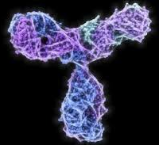

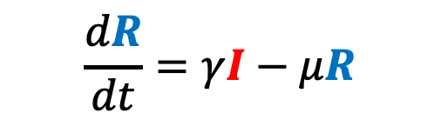

We can adapt the simple SIR model to better match our pathogen of interest and our corresponding data.
$$\frac{dS}{dt}=b(S+I+R)−βSI−μS$$
μ
μ
μ
$$\frac{dI}{dt}=βSI−γI−μI$$
β
γ
b
S
Susceptible
I
Infectious
R
Recovered
$$\frac{dR}{dt}=γI−μR$$

Slide 15

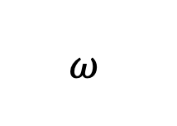
Incorporating Maternal Immunity
μ
b
μ
μ
μ
$$ω$$
β
γ
b
M
Maternally immune
S
Susceptible
I
Infectious
R
Recovered

Slide 16


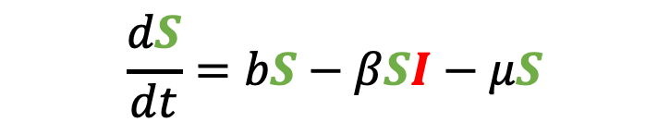
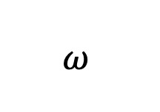
Incorporating Maternal Immunity
μ
b
μ
μ
μ
$$\frac{dS}{dt}=bS−βSI−μS$$
$$ω$$
β
γ
b
M
Maternally immune
S
Susceptible
I
Infectious
R
Recovered
$$\frac{dI}{dt}=βSI−γI−μI$$
$$\frac{dR}{dt}=γI−μR$$
What does our new equation look like?

Slide 17
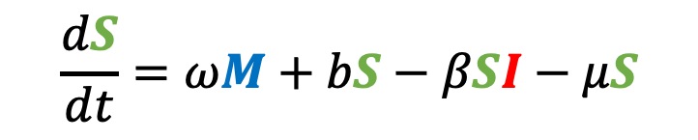
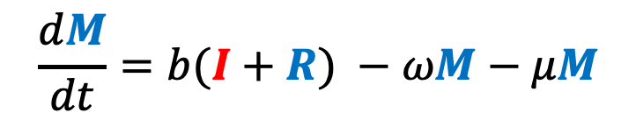
Incorporating Maternal Immunity
$$\frac{dM}{dt}=b(I+R) −ωM−μM$$
μ
b
μ
μ
μ
$$\frac{dS}{dt}=ωM+bS−βSI−μS$$
$$ω$$
β
γ
b
M
Maternally immune
S
Susceptible
I
Infectious
R
Recovered
$$\frac{dI}{dt}=βSI−γI−μI$$
$$\frac{dR}{dt}=γI−μR$$

Slide 18
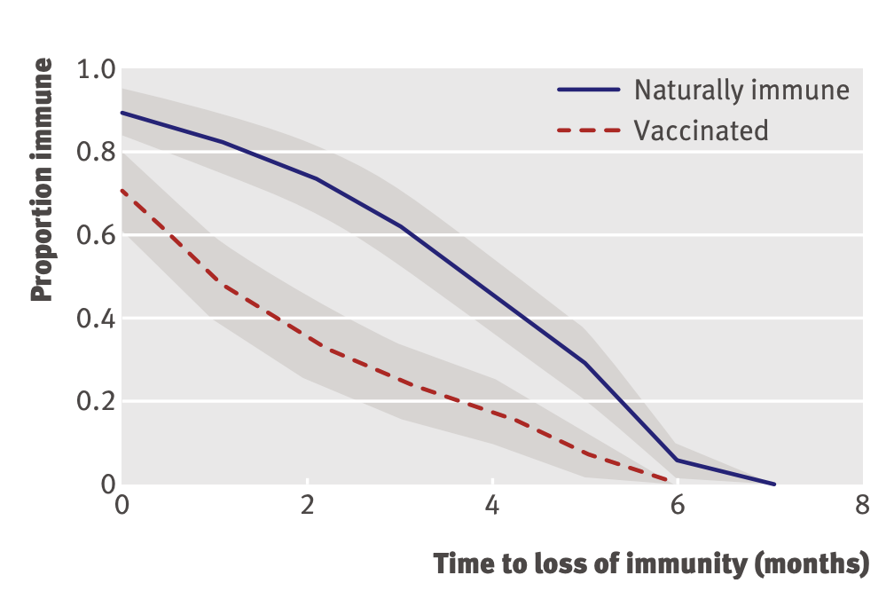
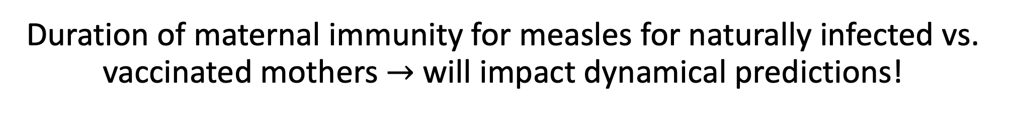
Duration of maternal immunity for measles for naturally infected vs. vaccinated mothers $→$ will impact dynamical predictions!
incorporating maternal immunity
Leuridan et al. 2010. BMJ.

Slide 19
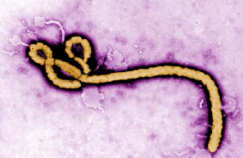
Pathogens exhibit diverse transmission mechanisms that require tailored modeling structures
Directly-transmitted diseases are transmitted via exchange of bodily fluids
Droplet (> 5 microns ) spread or direct contact
Includes sexually-transmitted pathogens, though often modeled with a more complex contact network
Smallpox (Variola spp.), HIV, Mononucleosis (Epstein Barr virus)
Indirectly-transmitted diseases are transmitted via droplets retained in air
Droplets < 5 microns in diameter
Measles, COVID (SARS-CoV-2)
μ
μ
μ
b
β
γ
S
I
R

Slide 20
Pathogens exhibit diverse transmission mechanisms that require tailored modeling structures
Environmentally-transmitted pathogens are transmitted outside of the host (e.g. water-borne, food-borne)
Examples: Cholera (Vibrio cholerae), Salmonellosis (Salmonella spp. bacteria), White-Nosed Syndrome (Pseudogymnoascus destructans)

Slide 21
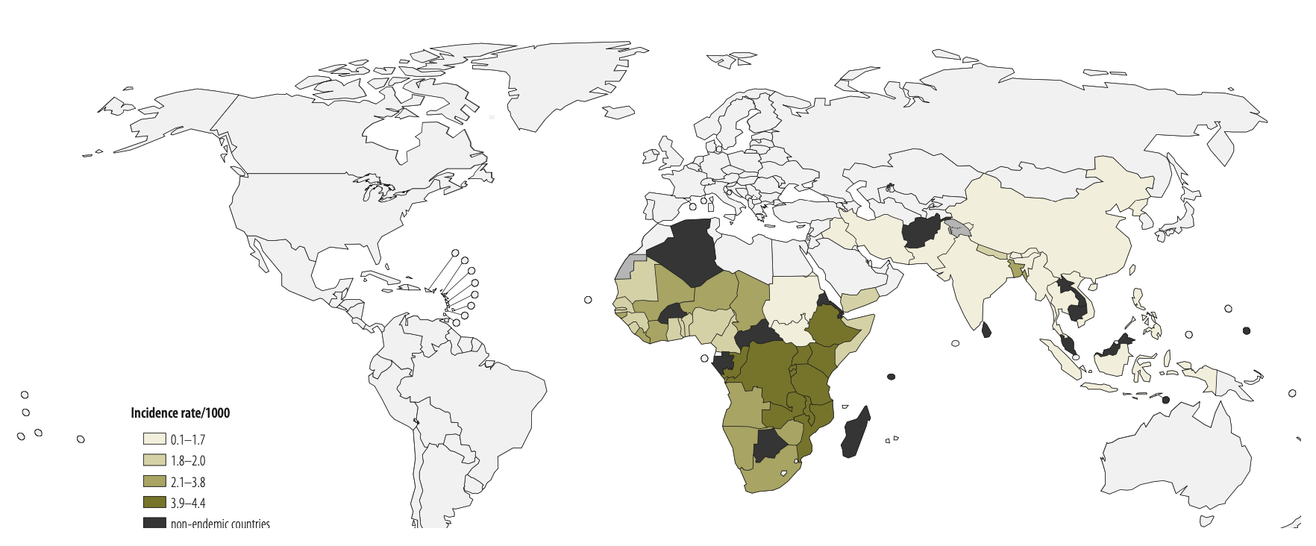
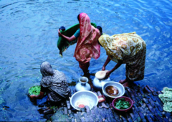
Pathogens exhibit diverse transmission mechanisms that require tailored modeling structures
Environmentally-transmitted pathogens are transmitted outside of the host (e.g. water-borne, food-borne)
Examples: Cholera (Vibrio cholerae), Salmonellosis (Salmonella spp. bacteria), White-Nosed Syndrome (Pseudogymnoascus destructans)
Global Burden of Cholera, 2012
Estimated 2.8 million cases & 95,000 deaths annually
Ali et al. 2012. WHO Bulletin.

Slide 22
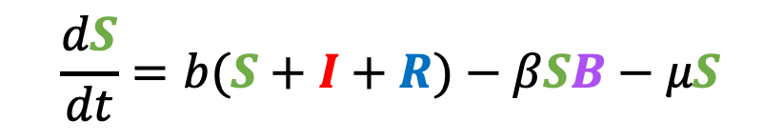

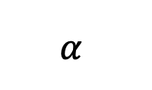
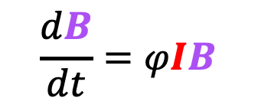
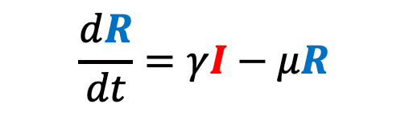
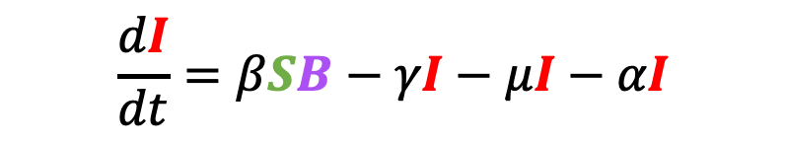
Pathogens exhibit diverse transmission mechanisms that require tailored modeling structures
Environmentally-transmitted pathogens are transmitted outside of the host (e.g. water-borne, food-borne)
Examples: Cholera (Vibrio cholerae), Salmonellosis (Salmonella spp. bacteria), White-Nosed Syndrome (Pseudogymnoascus destructans)
Here, the environmental reservoir is often modeled as its own population
μ
$$α$$
μ
μ
$$\frac{dB}{dt}=φIB$$
γ
b
β
S
I
R
$$\frac{dS}{dt}=b(S+I+R)−βSB−μS$$
$$\frac{dI}{dt}=βSB−γI−μI−αI$$
cholera environmental reservoir
$$φ$$
B
Bacteria
$$\frac{dR}{dt}=γI−μR$$
Codeço 2001. BMC Infectious Diseases.
Notes:
Kissing bugs = hemiptera = true bugs

Slide 23
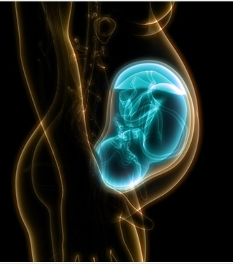
Pathogens exhibit diverse transmission mechanisms that require tailored modeling structures
Vertically-transmitted pathogens are transmitted mother-to-child in utero
Examples: HIV, Herpes simplex virus, Cytomegalovirus, Rubella, Zika

Slide 24
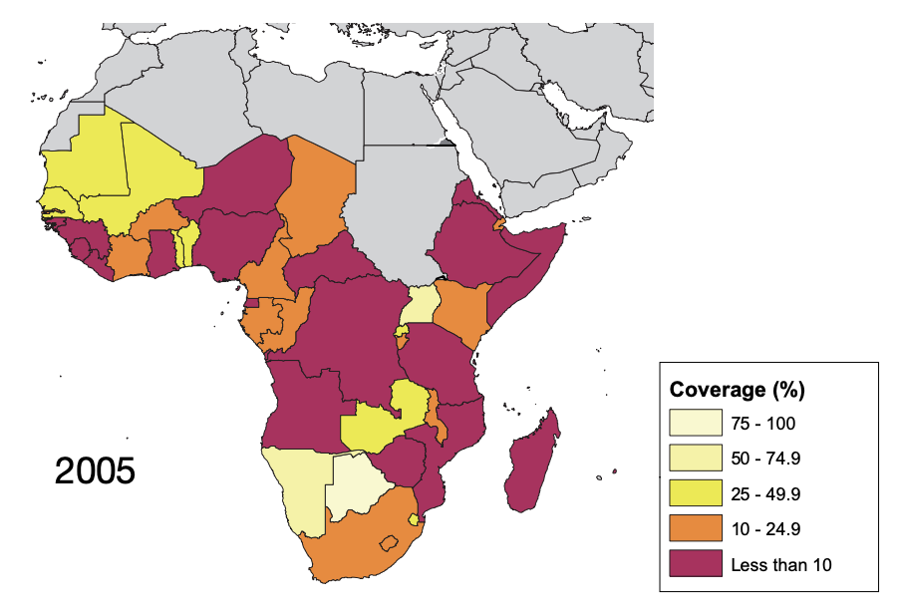
Pathogens exhibit diverse transmission mechanisms that require tailored modeling structures
Vertically-transmitted pathogens are transmitted mother-to-child in utero
Examples: HIV, Herpes simplex virus, Cytomegalovirus, Rubella, Zika
In untreated HIV+ mothers, rate of vertical transmission for HIV = 15-45%
Reduced to <1% for those on ART, though global access to ART is geographically heterogenous
ART coverage for those in need, from WHO

Slide 25
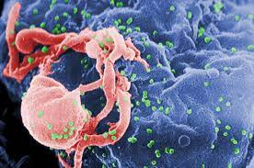

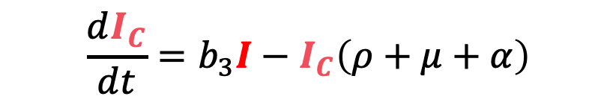
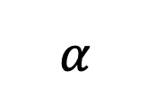
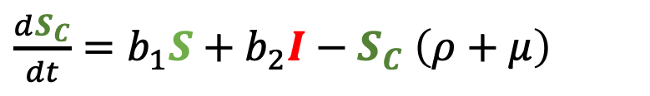

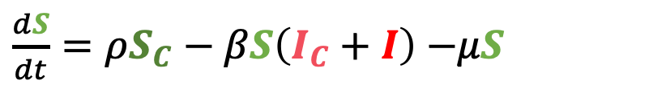
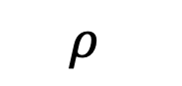
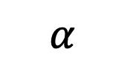
Pathogens exhibit diverse transmission mechanisms that require tailored modeling structures
Vertically-transmitted pathogens are transmitted mother-to-child in utero
Examples: HIV, Herpes simplex virus, Cytomegalovirus, Rubella, Zika
μ
I_{C}
b₃
$$α$$
$\frac{dS}{dt}=ρS_{C}−βS\left(I_{C}+I\right)$ $−μS$
$$ρ$$
$$\frac{dI}{dt}=βS\left(I_{C}+I\right)+ρI_{C}−μI−αI$$
μ
μ
$$α$$
S
β
I
$\frac{dS_{C}}{dt}=b_{1}S+b_{2}I−S_{C}$ $\left(ρ+μ\right)$
$$\frac{dI_{C}}{dt}=b_{3}I−I_{C}\left(ρ+μ+α\right)$$
$$ρ$$
b₂
S_{C}
b₁
μ
Yusuf et al. 2021. Chaos and Fractals.

Slide 26
Pathogens exhibit diverse transmission mechanisms that require tailored modeling structures
Vertically-transmitted pathogens are transmitted mother-to-child in utero
Examples: HIV, Herpes simplex virus, Cytomegalovirus, Rubella, Zika
μ
I_{C}
Vertical AND horizontal transmission!
b₃
$$α$$
$\frac{dS}{dt}=ρS_{C}−βS\left(I_{C}+I\right)$ $−μS$
$$ρ$$
$$\frac{dI}{dt}=βS\left(I_{C}+I\right)+ρI_{C}−μI−αI$$
μ
μ
$$α$$
S
β
I
$\frac{dS_{C}}{dt}=b_{1}S+b_{2}I−S_{C}$ $\left(ρ+μ\right)$
$$\frac{dI_{C}}{dt}=b_{3}I−I_{C}\left(ρ+μ+α\right)$$
$$ρ$$
b₂
S_{C}
b₁
μ
Yusuf et al. 2021. Chaos and Fractals.

Slide 27
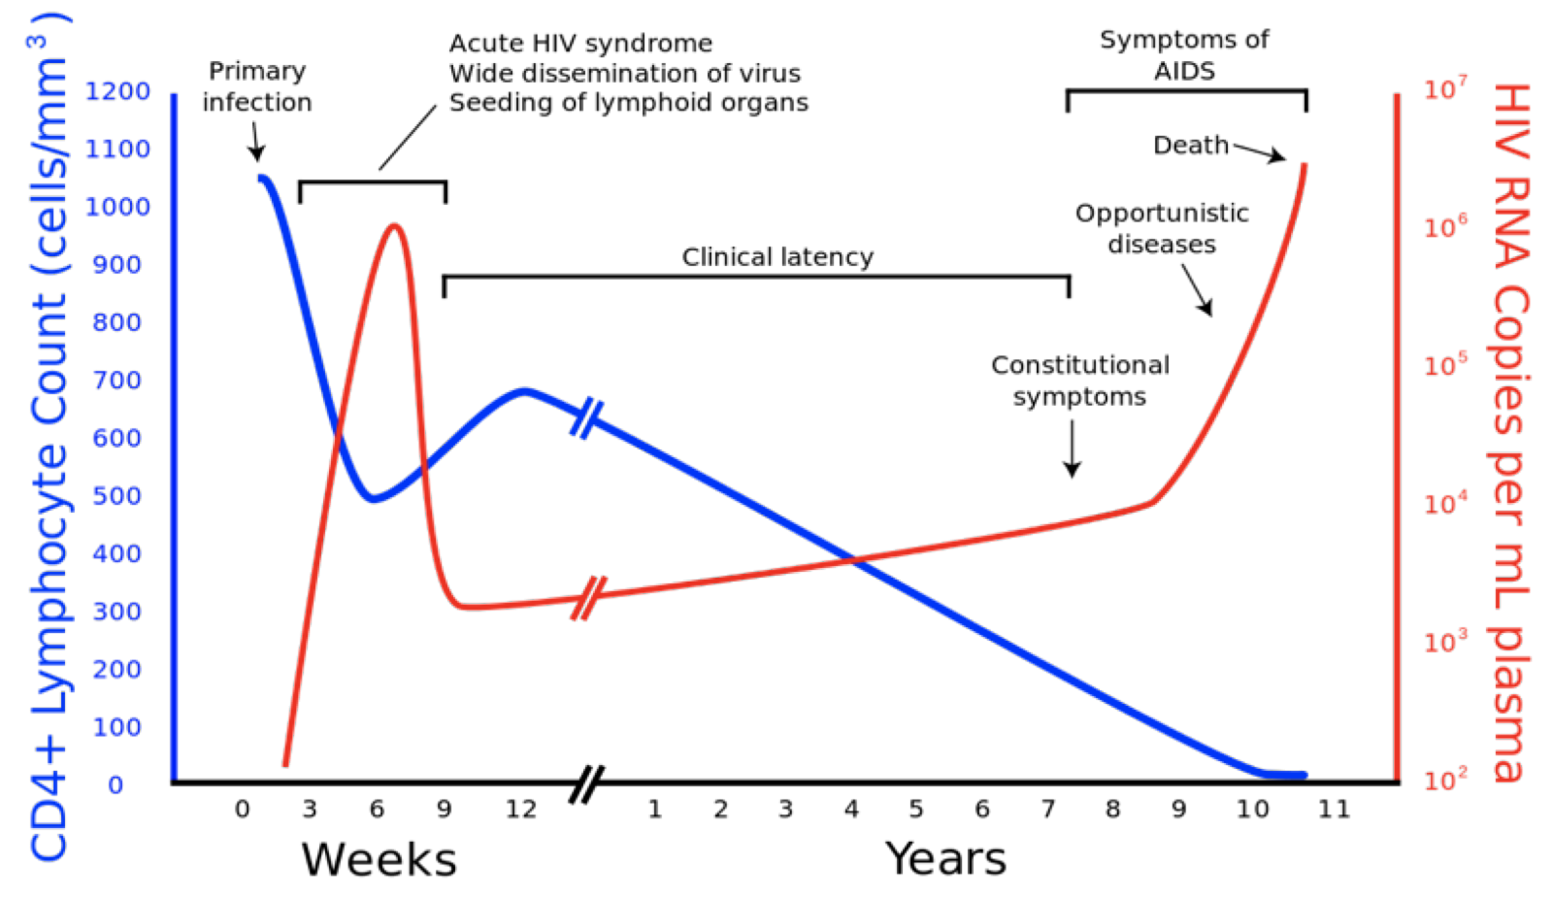
A brief interlude with some extra details about HIV
First recognized by newspapers in 1981 as gay men and injecting drug users in the US began reporting to hospitals with rare pneumonias and skin cancers
Widespread fear and intense stigma attributed to ‘gay cancer’
Virus co-discovered in 1983 by American Robert Gallo and Insitut Pasteur team, Françoise Barree-Sinoussi and Luc Montagnier
Early cases concentrated in gay men, injecting drug users, and hemophiliacs. Later understood that everyone was at risk
Immunocompromised patients pose risk for virus evolution.

Slide 28
A brief interlude with some extra details about HIV
First recognized by newspapers in 1981 as gay men and injecting drug users in the US began reporting to hospitals with rare pneumonias and skin cancers
Widespread fear and intense stigma attributed to ‘gay cancer’
Virus co-discovered in 1983 by American Robert Gallo and Insitut Pasteur team, Françoise Barree-Sinoussi and Luc Montagnier
Early cases concentrated in gay men, injecting drug users, and hemophiliacs. Later understood that everyone was at risk
Immunocompromised patients pose risk for virus evolution.
Early cases concentrated in gay men, injecting drug users, and hemophiliacs. Later understood that everyone was at risk
Immunocompromised patients pose risk for virus evolution.

Slide 29
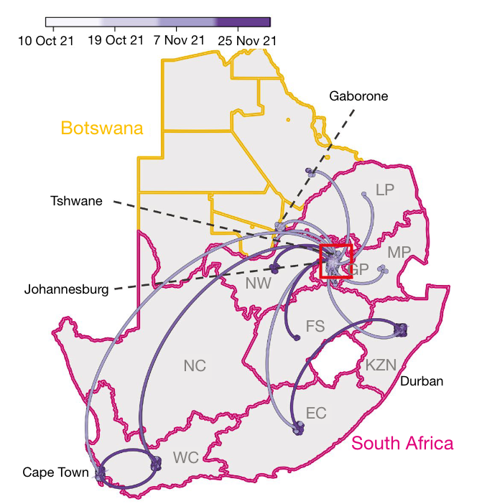
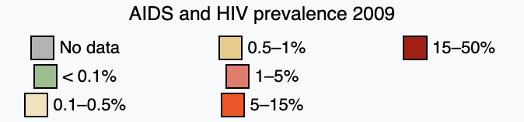
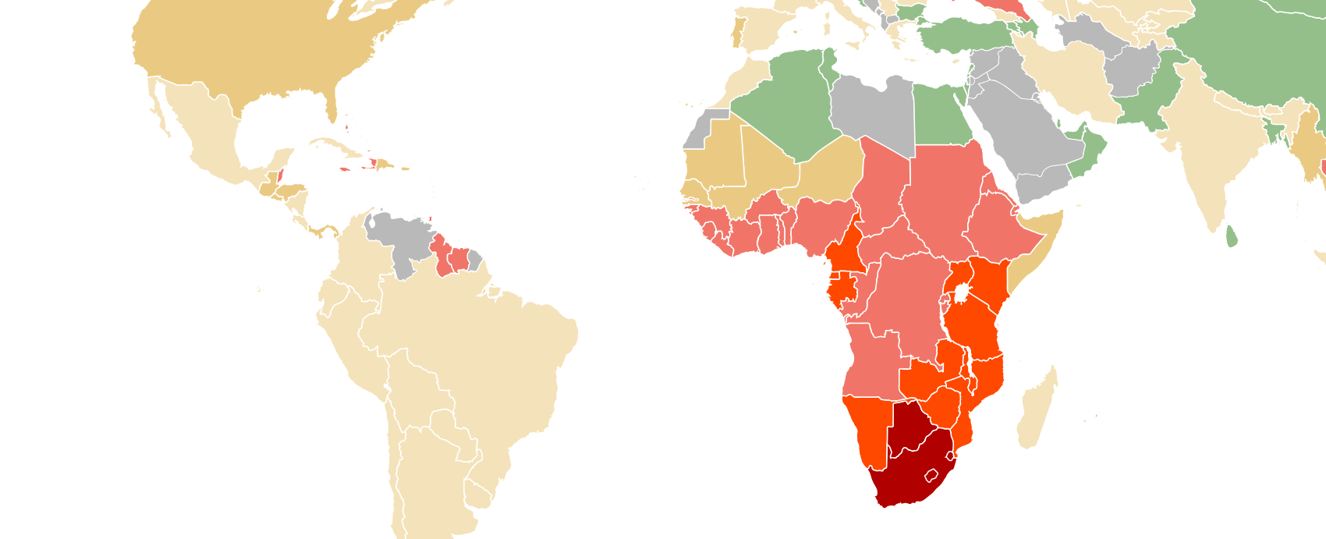
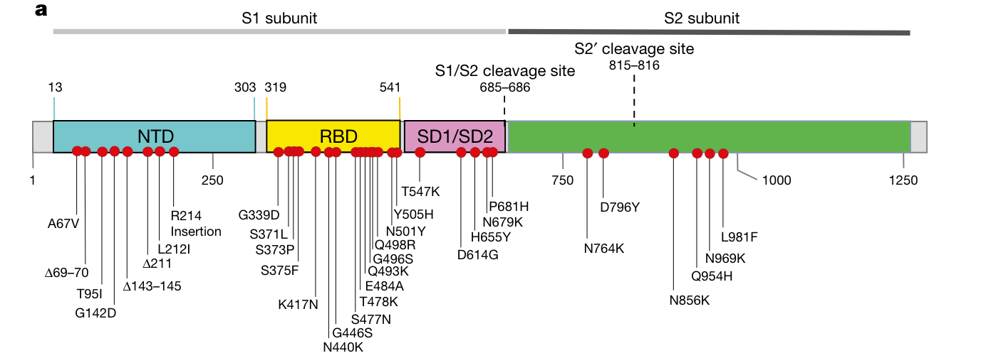
Immunocompromised patients pose risk for virus evolution.
Botswana HIV prevalence = 24.8%
South Africa HIV prevalence = 19%
>30 spike protein mutations in emerging Omicron
Viana et al. 2022. Nature.

Slide 30
“Ecology has a synonym which is ALL.”
Immunocompromised patients pose risk for virus evolution.
Botswana HIV prevalence = 24.8%
South Africa HIV prevalence = 19%
Immunocompromised patients pose risk for virus evolution.
>30 spike protein mutations in emerging Omicron
-John Steinbeck
The Log from the Sea of Cortez (1941)
Viana et al. 2022. Nature.

Slide 31
Pathogens exhibit diverse transmission mechanisms that require tailored modeling structures
Vector-borne diseases (a type of indirect transmission) are transmitted via blood-feeding arthropod (mosquitoes, ticks, fleas)
Notes:
Kissing bugs = hemiptera = true bugs

Slide 32
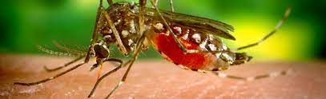
Pathogens exhibit diverse transmission mechanisms that require tailored modeling structures
Vector-borne diseases (a type of indirect transmission) are transmitted via blood-feeding arthropod (mosquitoes, ticks, fleas)
Euclidean vector: a quantity with a magnitude and direction
Epidemiological vector: an agent that carries and transmits an infectious patient into another living organism
Notes:
Kissing bugs = hemiptera = true bugs

Slide 33
Pathogens exhibit diverse transmission mechanisms that require tailored modeling structures
Vector-borne diseases (a type of indirect transmission) are transmitted via blood-feeding arthropod (mosquitoes, ticks, fleas)
Malaria: Mosquito-borne protozoan Plasmodium spp.
“Arboviruses”: Mosquito-borne viruses, including Dengue, Zika, Yellow fever virus, West Nile virus, Chikungunya virus
Sleeping sickness, also known as African trypanosomiasis: tsetse fly vector and protozoan pathogen (trypanosome)
Chagas disease: kissing bug vector and trypanosome pathogen
Plague: flea vector and bacterial pathogen (Yersinia pestis)
Notes:
Kissing bugs = hemiptera = true bugs

Slide 34
Pathogens exhibit diverse transmission mechanisms that require tailored modeling structures
Vector-borne diseases (a type of indirect transmission) are transmitted via blood-feeding arthropod (mosquitoes, ticks, fleas)
Malaria: Mosquito-borne protozoan Plasmodium spp.
“Arboviruses”: Mosquito-borne viruses, including Dengue, Zika, Yellow fever virus, West Nile virus, Chikungunya virus
Sleeping sickness, also known as African trypanosomiasis: tsetse fly vector and protozoan pathogen (trypanosome)
Chagas disease: kissing bug vector and trypanosome pathogen
Plague: flea vector and bacterial pathogen (Yersinia pestis)
Notes:
Kissing bugs = hemiptera = true bugs

Slide 35
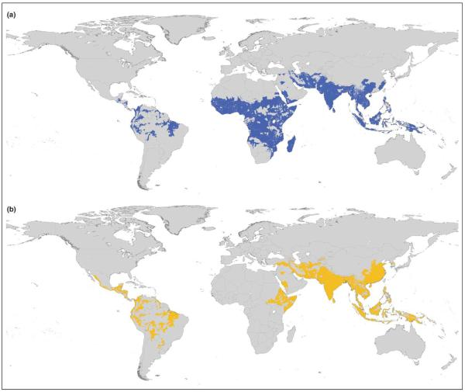
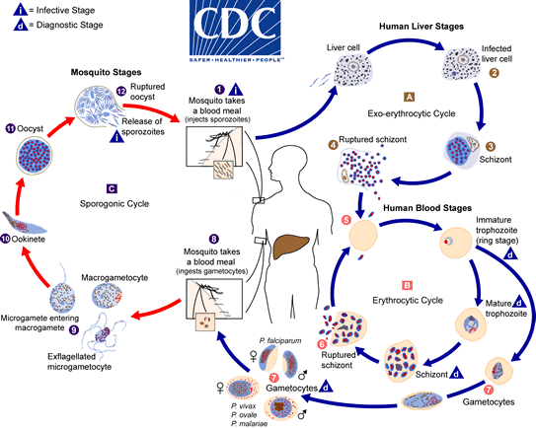
Malaria
4 main human Plasmodium parasites (falciparum, vivax, malariae, ovalae).
Over 200 Plasmodium spp. globally, infecting birds, reptiles, and other mammals (rodents, bats, primates)
Distribution Plasmodium falciparum
Distribution Plasmodium vivax
Guerra et al. 2006. Trends in Parasitology

Slide 36
Malaria
4 main human Plasmodium parasites (falciparum, vivax, malariae, ovalae).
Over 200 Plasmodium spp. globally, infecting birds, reptiles, and other mammals (rodents, bats, primates)
Distribution Plasmodium falciparum
Distribution Plasmodium vivax
Plasmodium parasites time RBC bursting such that they are at peak blood stage circulation when mosquito vectors are feeding at dusk!
Guerra et al. 2006. Trends in Parasitology

Slide 37
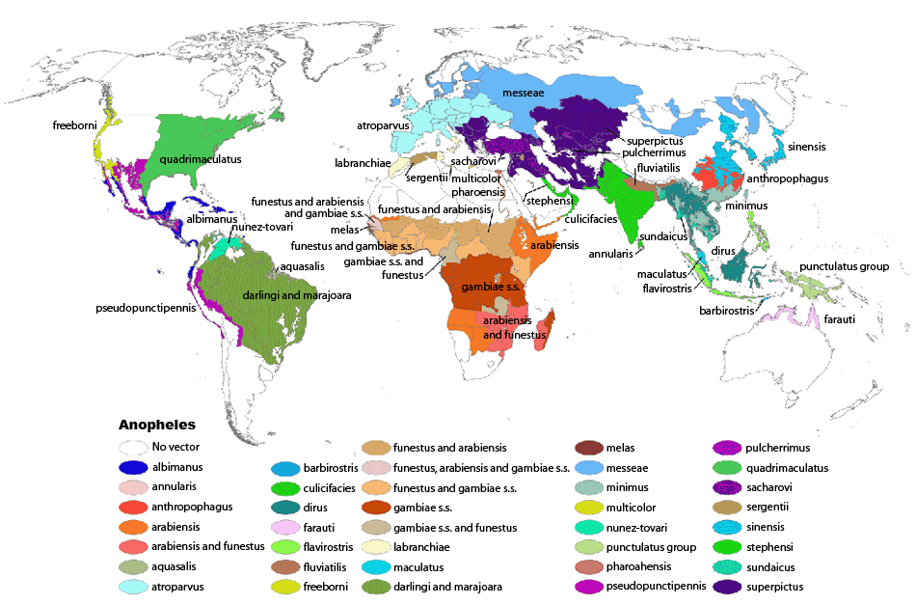
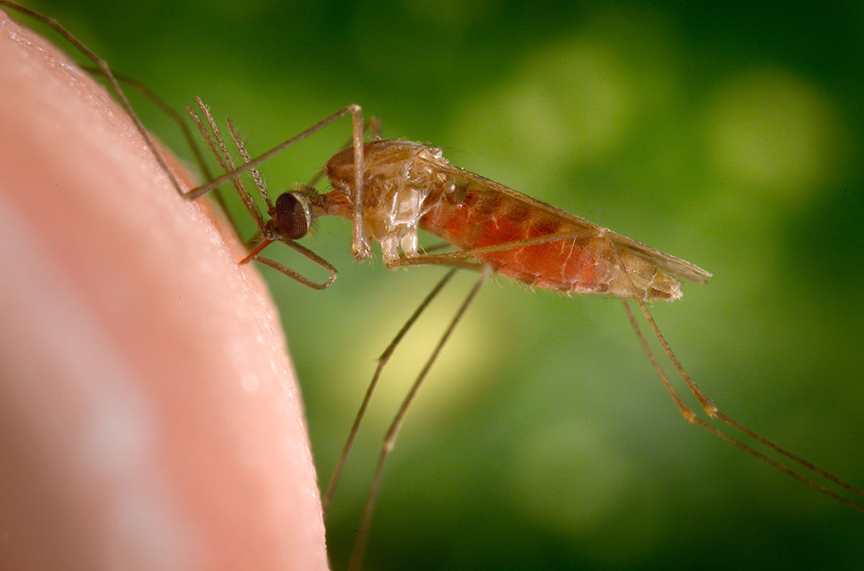
Malaria
4 main human Plasmodium parasites (falciparum, vivax, malariae, ovalae).
Over 200 Plasmodium spp. globally, infecting birds, reptiles, and other mammals (rodents, bats, primates)
>400 global species of Anopheles mosquito, >100 that can transmit human malaria
~30-40 Anopheles spp. most commonly implicated in human malaria transmission!
Kiszewksi et al. 2004. ASTMH.

Slide 38
Malaria
4 main human Plasmodium parasites (falciparum, vivax, malariae, ovalae).
Over 200 Plasmodium spp. globally, infecting birds, reptiles, and other mammals (rodents, bats, primates)
>400 global species of Anopheles mosquito, >100 that can transmit human malaria
~30-40 Anopheles spp. most commonly implicated in human malaria transmission!
Only female mosquitoes feed on blood!
Male mosquitoes feed on plant nectar.
Kiszewksi et al. 2004. ASTMH.

Slide 39
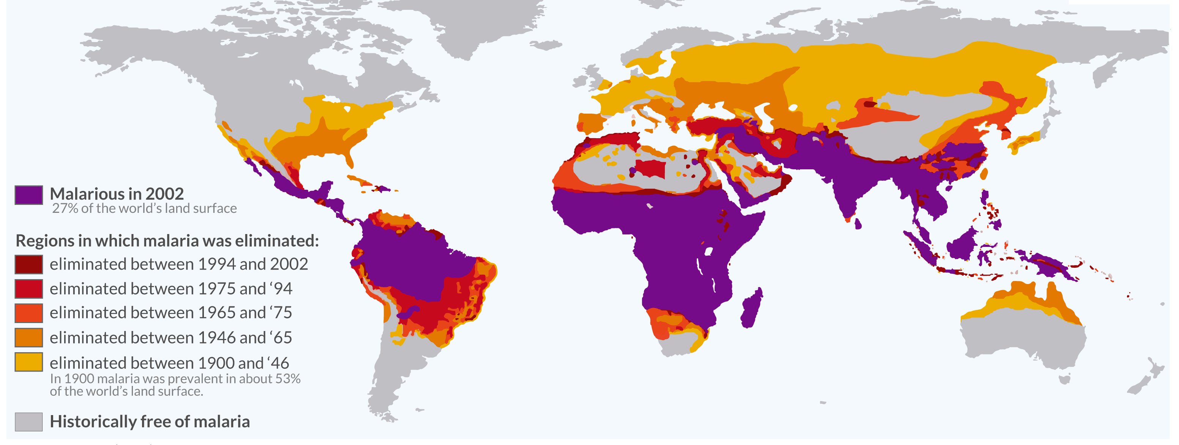
Malaria has been eliminated from many regions where it was previously endemic, including the US.
Still one of the leading causes of child mortality globally – responsible for about half a million childhood deaths a year, 80% in Africa.
OurWorldinData.org

Slide 40

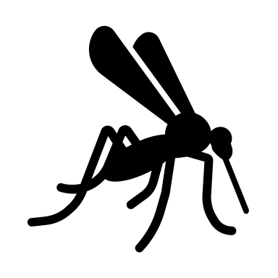
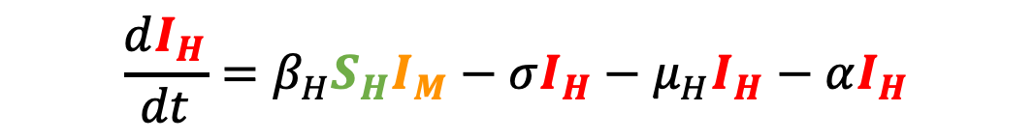
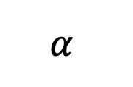
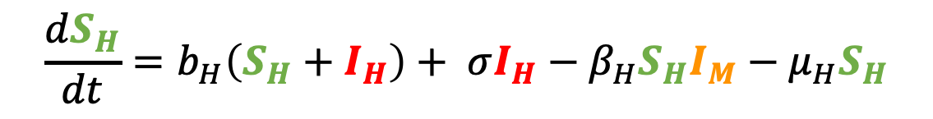

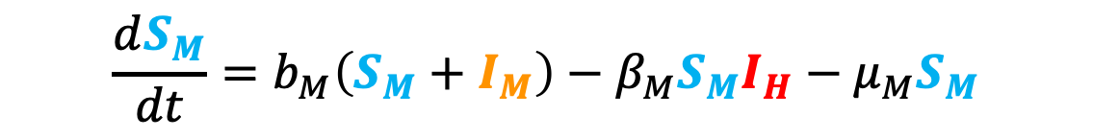
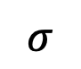
Malaria models have played a critical role in public health policy for over a century.
$$σ$$
1911: British medical Dr. Sir Ronald Ross developed the first model of malaria while working in the Indian Medical Service.
He had already won the 1902 Nobel prize in physiology and medicine for discovering the life cycle of avian malaria
μ_{H}
μ_{H}
b_{H}
β_{H}
$$α$$
S_{H}
I_{H}
$$\frac{dS_{H}}{dt}=b_{H}\left(S_{H}+I_{H}\right)+ σI_{H}−β_{H}S_{H}I_{M}−μ_{H}S_{H}$$
b_{M}
S_{M}
β_{M}
I_{M}
$$\frac{dI_{H}}{dt}=β_{H}S_{H}I_{M}−σI_{H}−μ_{H}I_{H}−αI_{H}$$
μ_{M}
μ_{M}
$$\frac{dS_{M}}{dt}=b_{M}\left(S_{M}+I_{M}\right)−β_{M}S_{M}I_{H}−μ_{M}S_{M}$$
$$\frac{dI_{M}}{dt}=β_{M}S_{M}I_{H}−μ_{M}I_{M}$$

Slide 41

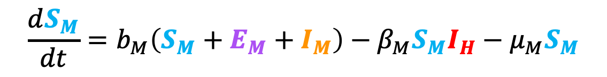
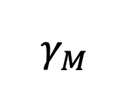

Malaria models have played a critical role in public health policy for over a century.
$$σ$$
1911: British medical Dr. Sir Ronald Ross developed the first model of malaria while working in the Indian Medical Service.
1957: MacDonald modified this model to include the latent period of the parasite developing in the mosquito.
He implicated the survivorship of the female mosquito as the weakest link in the life cycle!
μ_{H}
μ_{H}
b_{H}
β_{H}
$$α$$
S_{H}
I_{H}
b_{M}
β_{M}
$$γ_{M}$$
S_{M}
E_{M}
I_{M}
$$\frac{dS_{M}}{dt}=b_{M}\left(S_{M}+E_{M}+I_{M}\right)−β_{M}S_{M}I_{H}−μ_{M}S_{M}$$
μ_{M}
μ_{M}
μ_{M}
$$\frac{dE_{M}}{dt}=β_{M}S_{M}I_{H}−μ_{M}E_{M}−γ_{M}E_{M}$$
$$\frac{dI_{M}}{dt}=γ_{M}E_{M}−μ_{M}I_{M}$$

Slide 42
Malaria models have played a critical role in public health policy for over a century.
$$σ$$
1911: British medical Dr. Sir Ronald Ross developed the first model of malaria while working in the Indian Medical Service.
1957: MacDonald modified this model to include the latent period of the parasite developing in the mosquito.
This led to a widespread WHO campaign for malaria elimination using DDT in the 1950s!
Swiss chemist Paul Müller awarded 1948 Nobel Prize in medicine and physiology for discovering DDT and its impacts on arthropods
DDT played a major role in eliminating malaria from Europe and North America
DDT bioaccumulates and is carcinogenic – led to development of an environmental backlash in the US, culminating in Rachel Carson’s 1962 book Silent Spring
DDT banned globally in 2004, excepting in cases of WHO-recommended indoor residual spraying (IRS) for vector control in malaria-endemic regions
μ_{H}
μ_{H}
b_{H}
β_{H}
$$α$$
S_{H}
I_{H}
b_{M}
β_{M}
$$γ_{M}$$
S_{M}
E_{M}
I_{M}
μ_{M}
μ_{M}
μ_{M}

Slide 43
Malaria models have played a critical role in public health policy for over a century.
$$σ$$
1911: British medical Dr. Sir Ronald Ross developed the first model of malaria while working in the Indian Medical Service.
1957: MacDonald modified this model to include the latent period of the parasite developing in the mosquito.
This led to a widespread WHO campaign for malaria elimination using DDT in the 1950s!
Swiss chemist Paul Müller awarded 1948 Nobel Prize in medicine and physiology for discovering DDT and its impacts on arthropods
DDT played a major role in eliminating malaria from Europe and North America
DDT bioaccumulates and is carcinogenic – led to development of an environmental backlash in the US, culminating in Rachel Carson’s 1962 book Silent Spring
DDT banned globally in 2004, excepting in cases of WHO-recommended indoor residual spraying (IRS) for vector control in malaria-endemic regions
μ_{H}
μ_{H}
b_{H}
β_{H}
$$α$$
S_{H}
I_{H}
b_{M}
β_{M}
$$γ_{M}$$
S_{M}
E_{M}
I_{M}
μ_{M}
μ_{M}
μ_{M}

Slide 44
Malaria models have played a critical role in public health policy for over a century.
$$σ$$
1911: British medical Dr. Sir Ronald Ross developed the first model of malaria while working in the Indian Medical Service.
1957: MacDonald modified this model to include the latent period of the parasite developing in the mosquito.
This led to a widespread WHO campaign for malaria elimination using DDT in the 1950s!
Swiss chemist Paul Müller awarded 1948 Nobel Prize in medicine and physiology for discovering DDT and its impacts on arthropods
DDT played a major role in eliminating malaria from Europe and North America
DDT bioaccumulates and is carcinogenic – led to development of an environmental backlash in the US, culminating in Rachel Carson’s 1962 book Silent Spring
DDT banned globally in 2004, excepting in cases of WHO-recommended indoor residual spraying (IRS) for vector control in malaria-endemic regions
μ_{H}
μ_{H}
b_{H}
β_{H}
$$α$$
S_{H}
I_{H}
b_{M}
β_{M}
$$γ_{M}$$
S_{M}
E_{M}
I_{M}
μ_{M}
μ_{M}
μ_{M}

Slide 45
Malaria models have played a critical role in public health policy for over a century.
$$σ$$
1911: British medical Dr. Sir Ronald Ross developed the first model of malaria while working in the Indian Medical Service.
1957: MacDonald modified this model to include the latent period of the parasite developing in the mosquito.
This led to a widespread WHO campaign for malaria elimination using DDT in the 1950s!
Swiss chemist Paul Müller awarded 1948 Nobel Prize in medicine and physiology for discovering DDT and its impacts on arthropods
DDT played a major role in eliminating malaria from Europe and North America
DDT bioaccumulates and is carcinogenic – led to development of an environmental backlash in the US, culminating in Rachel Carson’s 1962 book Silent Spring
DDT banned globally in 2004, excepting in cases of WHO-recommended indoor residual spraying (IRS) for vector control in malaria-endemic regions
μ_{H}
μ_{H}
b_{H}
β_{H}
$$α$$
S_{H}
I_{H}
b_{M}
β_{M}
$$γ_{M}$$
S_{M}
E_{M}
I_{M}
μ_{M}
μ_{M}
μ_{M}

Slide 46
Malaria models have played a critical role in public health policy for over a century.
$$σ$$
1911: British medical Dr. Sir Ronald Ross developed the first model of malaria while working in the Indian Medical Service.
1957: MacDonald modified this model to include the latent period of the parasite developing in the mosquito.
This led to a widespread WHO campaign for malaria elimination using DDT in the 1950s!
Swiss chemist Paul Müller awarded 1948 Nobel Prize in medicine and physiology for discovering DDT and its impacts on arthropods
DDT played a major role in eliminating malaria from Europe and North America
DDT bioaccumulates and is carcinogenic – led to development of an environmental backlash in the US, culminating in Rachel Carson’s 1962 book Silent Spring
DDT banned globally in 2004, excepting in cases of WHO-recommended indoor residual spraying (IRS) for vector control in malaria-endemic regions
μ_{H}
μ_{H}
b_{H}
β_{H}
$$α$$
S_{H}
I_{H}
b_{M}
β_{M}
$$γ_{M}$$
S_{M}
E_{M}
I_{M}
μ_{M}
μ_{M}
μ_{M}

Slide 47
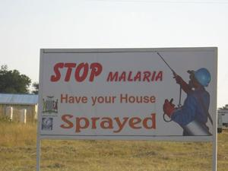
Malaria models have played a critical role in public health policy for over a century.
1911: British medical Dr. Sir Ronald Ross developed the first model of malaria while working in the Indian Medical Service.
1957: MacDonald modified this model to include the latent period of the parasite developing in the mosquito.
This led to a widespread WHO campaign for malaria elimination using DDT in the 1950s!
Swiss chemist Paul Müller awarded 1948 Nobel Prize in medicine and physiology for discovering DDT and its impacts on arthropods
DDT played a major role in eliminating malaria from Europe and North America
DDT bioaccumulates and is carcinogenic – led to development of an environmental backlash in the US, culminating in Rachel Carson’s 1962 book Silent Spring
DDT banned globally in 2004, excepting in cases of WHO-recommended indoor residual spraying (IRS) for vector control in malaria-endemic regions

Slide 48
“Ecology has a synonym which is ALL.”
Malaria models have played a critical role in public health policy for over a century.
1911: British medical Dr. Sir Ronald Ross developed the first model of malaria while working in the Indian Medical Service.
1957: MacDonald modified this model to include the latent period of the parasite developing in the mosquito.
This led to a widespread WHO campaign for malaria elimination using DDT in the 1950s!
Swiss chemist Paul Müller awarded 1948 Nobel Prize in medicine and physiology for discovering DDT and its impacts on arthropods
DDT played a major role in eliminating malaria from Europe and North America
DDT bioaccumulates and is carcinogenic – led to development of an environmental backlash in the US, culminating in Rachel Carson’s 1962 book Silent Spring
DDT banned globally in 2004, excepting in cases of WHO-recommended indoor residual spraying (IRS) for vector control in malaria-endemic regions
-John Steinbeck
The Log from the Sea of Cortez (1941)

Slide 49
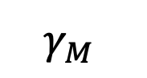
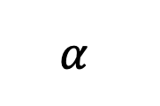
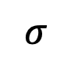




Malaria models have played a critical role in public health policy for over a century.
1911: British medical Dr. Sir Ronald Ross developed the first model of malaria while working in the Indian Medical Service.
1957: MacDonald modified this model to include the latent period of the parasite in the mosquito.
This led to a widespread WHO campaign for malaria elimination using DDT in the 1950s!
1991: Anderson and May extended model to show latency in the human population.
$$σ$$
μ_{H}
μ_{H}
μ_{H}
b_{H}
β_{H}
S_{H}
E_{H}
$$γ_{H}$$
I_{H}
$$α$$
b_{M}
S_{M}
β_{M}
E_{M}
$$γ_{M}$$
I_{M}
μ_{M}
μ_{M}
μ_{M}
$$\frac{dS_{H}}{dt}=b_{H}\left(S_{H}+E_{H}+I_{H}\right)+ σI_{H}−β_{H}S_{H}I_{M}−μ_{H}S_{H}$$
$$\frac{dE_{H}}{dt}=β_{H}S_{H}I_{M}−γ_{H}E_{H}−μ_{H}E_{H}$$
$$\frac{dI_{H}}{dt}=γ_{H}E_{H}−σI_{H}−μ_{H}I_{H}−αI_{H}$$

Slide 50

Malaria models have played a critical role in public health policy for over a century.
Mandal et al. 2011. Malaria Journal.

Slide 51

Challenges to malaria elimination
Herd immunity threshold (HIT)

Slide 52

Challenges to malaria elimination
High parasite diversity: sexual reproduction in 4+ Plasmodium species
Fast evolution of resistance (e.g. to drugs)
Many possible vectors! Potentially additional possible reservoirs!
Latent cases as burden is reduced
Vaccine candidates: what life stage to target?
Mosquirix pre-erythrocytic vaccine licensed in 2022
Requires at least 3 doses in children <2
Does not eliminate pathogen but reduces severe malaria burden and burden of hospitalization

Slide 53
Pathogens exhibit diverse transmission mechanisms that require tailored modeling structures
Vector-borne diseases (a type of indirect transmission) are transmitted via blood-feeding arthropod (mosquitoes, ticks, fleas)
Malaria: Mosquito-borne protozoan Plasmodium spp.
“Arboviruses”: Mosquito-borne viruses, including Dengue, Zika, Yellow fever virus, West Nile virus, Chikungunya virus
Sleeping sickness, also known as African trypanosomiasis: tsetse fly vector and protozoan pathogen (trypanosome)
Chagas disease: kissing bug vector and trypanosome pathogen
Plague: flea vector and bacterial pathogen (Yersinia pestis)
Notes:
Kissing bugs = hemiptera = true bugs

Slide 54
Pathogens exhibit diverse transmission mechanisms that require tailored modeling structures
Vector-borne diseases (a type of indirect transmission) are transmitted via blood-feeding arthropod (mosquitoes, ticks, fleas)
Malaria: Mosquito-borne protozoan Plasmodium spp.
“Arboviruses”: Mosquito-borne viruses, including Dengue, Zika, Yellow fever virus, West Nile virus, Chikungunya virus
Sleeping sickness, also known as African trypanosomiasis: tsetse fly vector and protozoan pathogen (trypanosome)
Chagas disease: kissing bug vector and trypanosome pathogen
Plague: flea vector and bacterial pathogen (Yersinia pestis)
Plague is BOTH vector-borne and zoonotic!
Notes:
Kissing bugs = hemiptera = true bugs

Slide 55


spillover
reservoir host
spillover host
transmission
(can occur directly or via vector)
Spillover occurs when a pathogen transmits from one species host to another
Notes:
Emerging infectious diseases can be defined as infectious diseases that have newly appeared in a population or have existed but are rapidly increasing in incidence or geographic range, or that are caused by one of the NIAID Category A, B, or C priority pathogens.

Slide 56
zoonosis
reservoir host
spillover host
transmission
(can occur directly or via vector)
Over 60% of all ‘emerging’ infectious diseases are zoonotic,
meaning transmitted from an animal reservoir to a human host.
(Emerging infectious have newly appeared or are increasing in incidence or geographic range, or caused by NIAID priority pathogens)
Notes:
Emerging infectious diseases can be defined as infectious diseases that have newly appeared in a population or have existed but are rapidly increasing in incidence or geographic range, or that are caused by one of the NIAID Category A, B, or C priority pathogens.

Slide 57


zoonosis
vector
reservoir host
spillover host
transmission
Over 60% of all ‘emerging’ infectious diseases are zoonotic,
meaning transmitted from an animal reservoir to a human host.
Animal hosts are not vectors!

Slide 58





Pathogens can also spillover to alternative wildlife hosts.
reservoir host
spillover hosts
transmission
These pathogens are not considered zoonoses unless they spillover to humans!

Slide 59


spillback
reservoir host
spillover host
transmission
when pathogens transmit from a spillover host back to the original reservoir host
(example: transmission of SARS-CoV-2 from mink back to humans… interesting case because neither humans nor mink are actually the original reservoir host)
Notes:
Emerging infectious diseases can be defined as infectious diseases that have newly appeared in a population or have existed but are rapidly increasing in incidence or geographic range, or that are caused by one of the NIAID Category A, B, or C priority pathogens.

Slide 60




Spillback occurs among wildlife as well
reservoir host
spillover hosts
transmission
cattle
wild ungulate
Cattle sourced Brucella to wild ungulates in Yellowstone National Park, which now serve as a source for reinfection to cattle.
Dobson and Meagher. 1996. Ecology.

Slide 61
For next year, I would introduce these term slides before the spillover slides

Slide 62

Defining terms in multi-species infections…
Haydon et al. 2002. EID.
Lembo et al. 2008. J of Animal Ecology.

Slide 63
Defining terms in multi-species infections…
population of interest to the study
population[s] sourcing pathogen to target population
Haydon et al. 2002. EID.
Lembo et al. 2008. J of Animal Ecology.

Slide 64
Defining terms in multi-species infections…
spillover hosts only
population of interest to the study
population[s] sourcing pathogen to target population
population can sustain endemic transmission of pathogen
Haydon et al. 2002. EID.
Lembo et al. 2008. J of Animal Ecology.

Slide 65

Defining terms in multi-species infections…
Haydon et al. 2002. EID.
Lembo et al. 2008. J of Animal Ecology.

Slide 66

Pathogens can also spillover to alternative wildlife hosts.
Serengeti District, Tanzania
Cases of Rabies
Cases of Rabies
Ngorogoro District, Tanzania
Lembo et al. 2008. J of Animal Ecology.

Slide 67

Vaccination of domestic dogs aims to shift the ecology of the system
Haydon et al. 2002. EID.
Lembo et al. 2008. J of Animal Ecology.

Slide 68

Vaccination of domestic dogs can successfully eradicate rabies from some systems.
dog cases
dog vaccination coverage
Lushashi et al. In Revision. The Lancet.

Slide 69





Pathogens can be classed according to their host relationships.
Stage I
Stage II
Stage III
Stage IV
Stage V
Transmits exclusively in humans
Transmits exclusively in animals
Human cases from spillovers only
Stuttering chains of transmission in humans
Sustained transmission and human outbreaks
canine parvovirus
rabies virus
monkeypox (pre-2022)
Ebola virus (especially post-2014)
Tuberculosis
Lloyd-Smith et al. 2009. Science.

Slide 70

Pathogens can be classed according to their host relationships.
Stage I
Stage II
Stage III
Stage IV
Stage V
Transmits exclusively in humans
Transmits exclusively in animals
Human cases from spillovers only
Stuttering chains of transmission in humans
Sustained transmission and human outbreaks
canine parvovirus
rabies virus
monkeypox (pre-2022)
Ebola virus (especially post-2014)
Tuberculosis
R₀ < 1
R₀ $≈$ 1
R₀ > 1
Zoonotic pathogens can be classed according to their R₀ in humans.
Lloyd-Smith et al. 2009. Science.

Slide 71

Most stage V pathogens once had an animal origin, as well!
Stage V
Transmits exclusively in humans
HIV
Sharp & Hahn. 2011. Cold Spring Harb Perspect Med.

